Slide 1

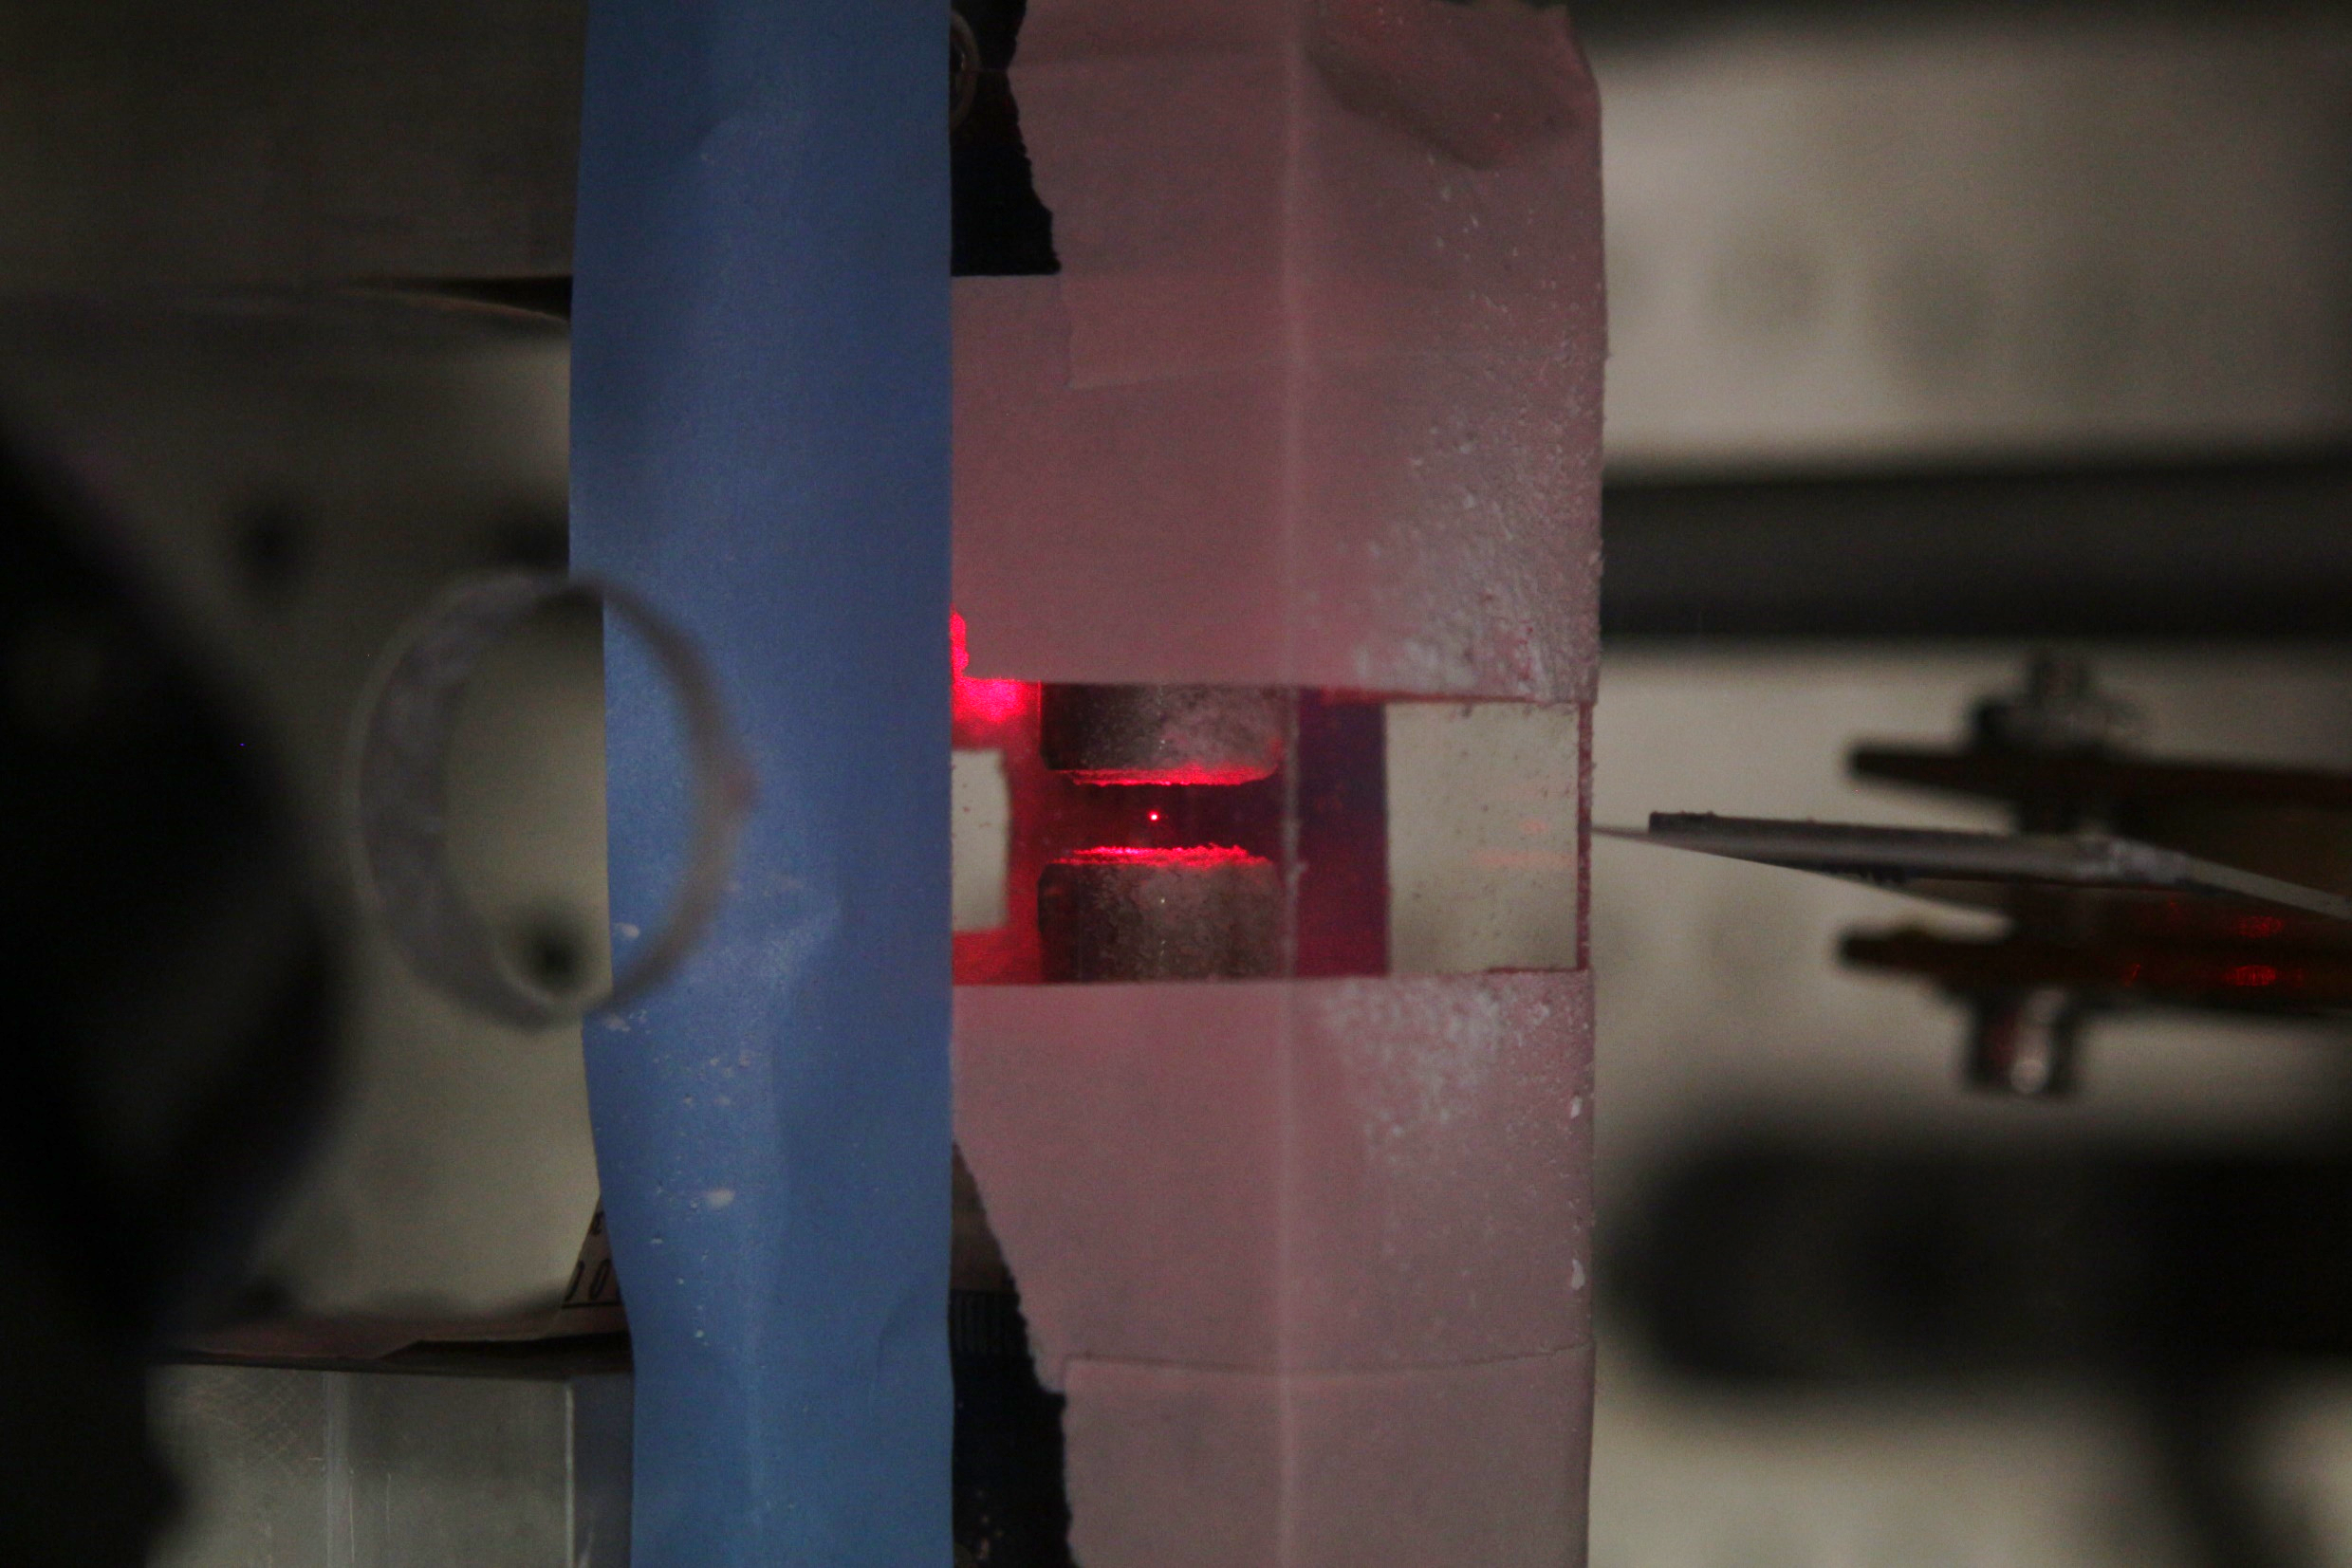
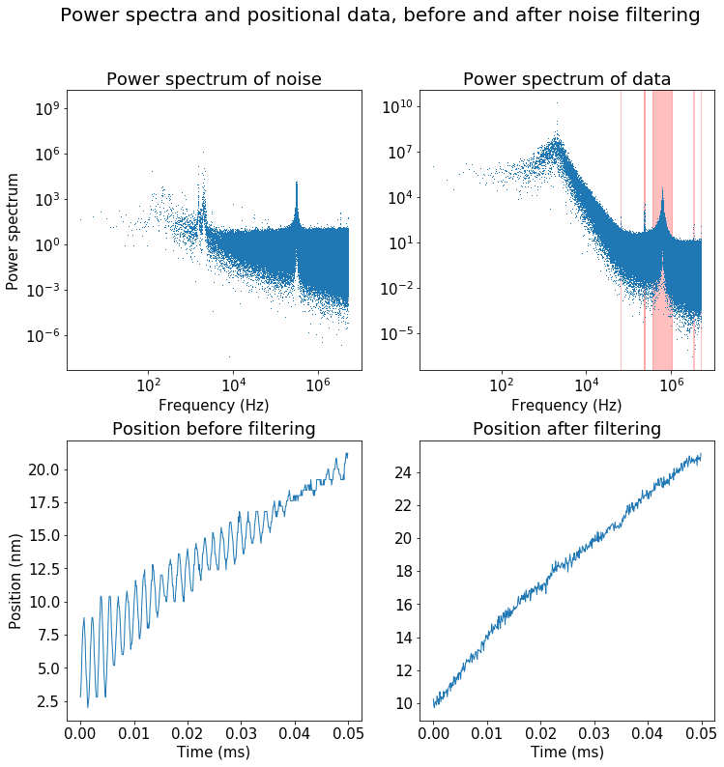
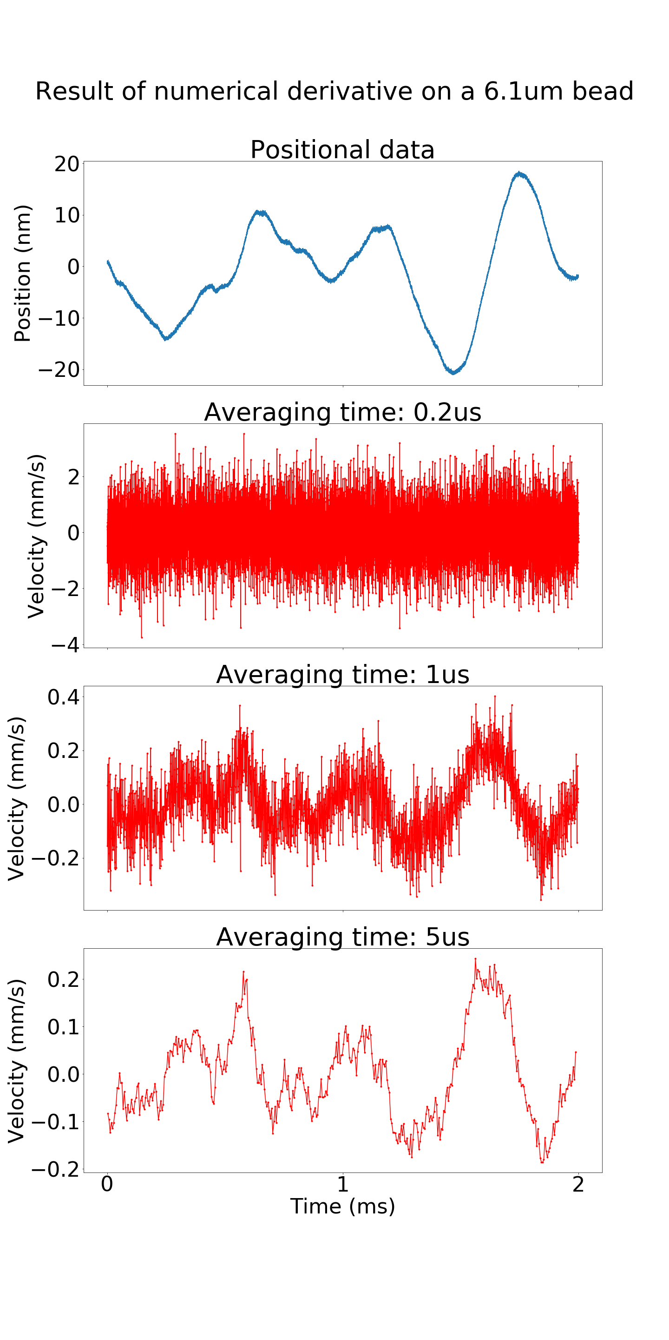
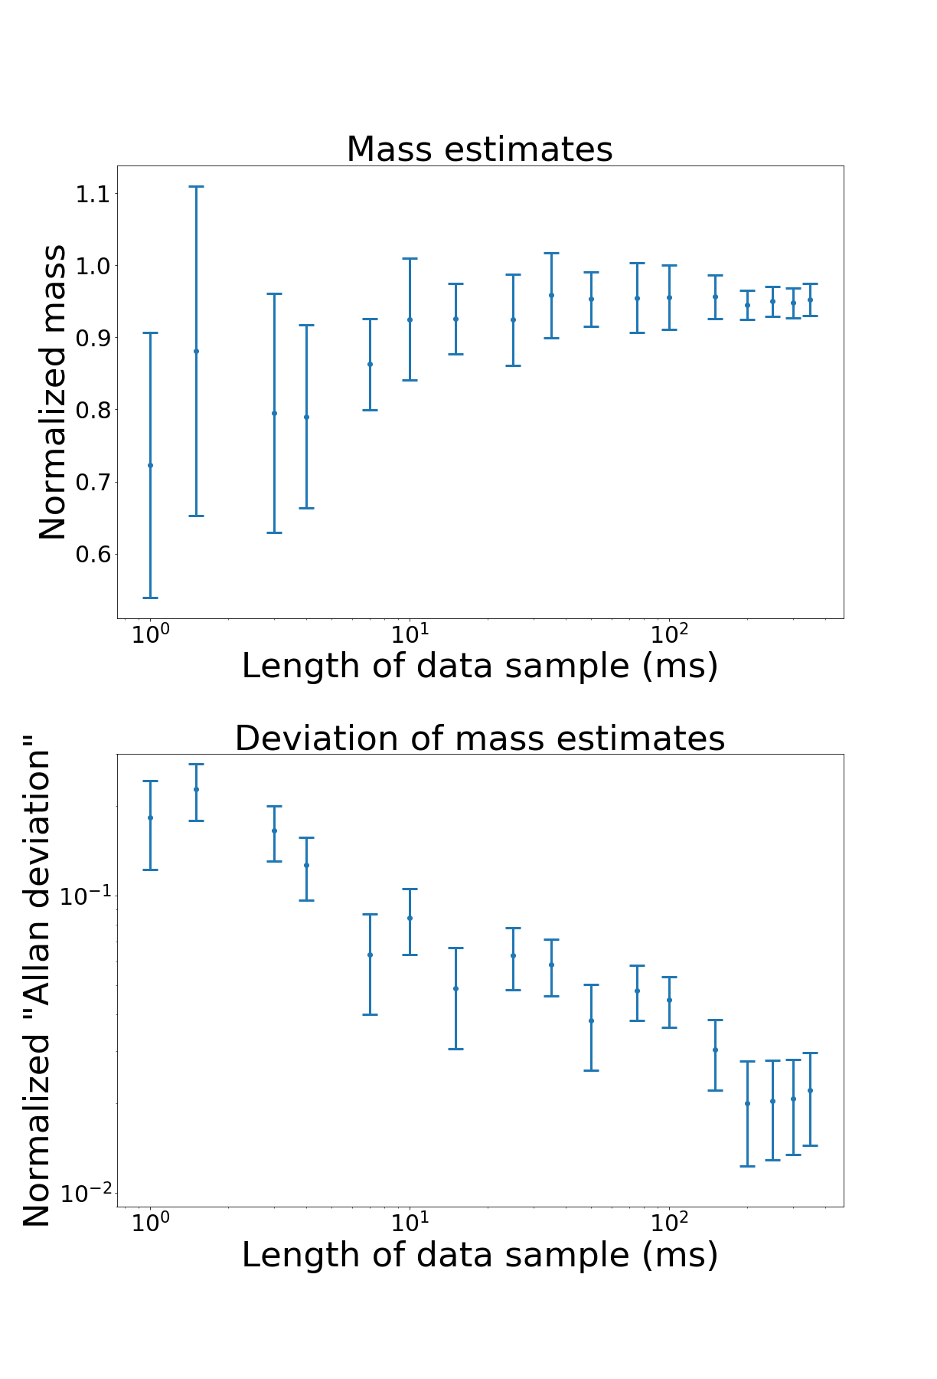
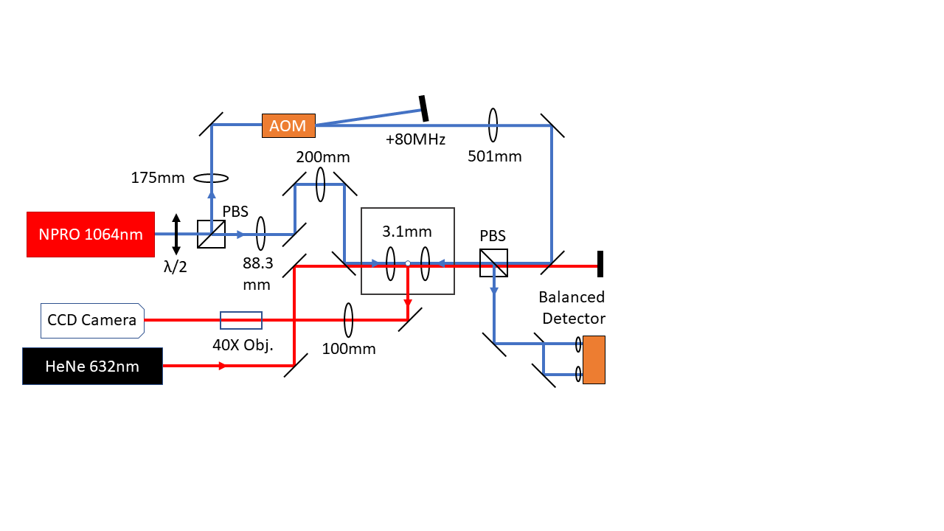
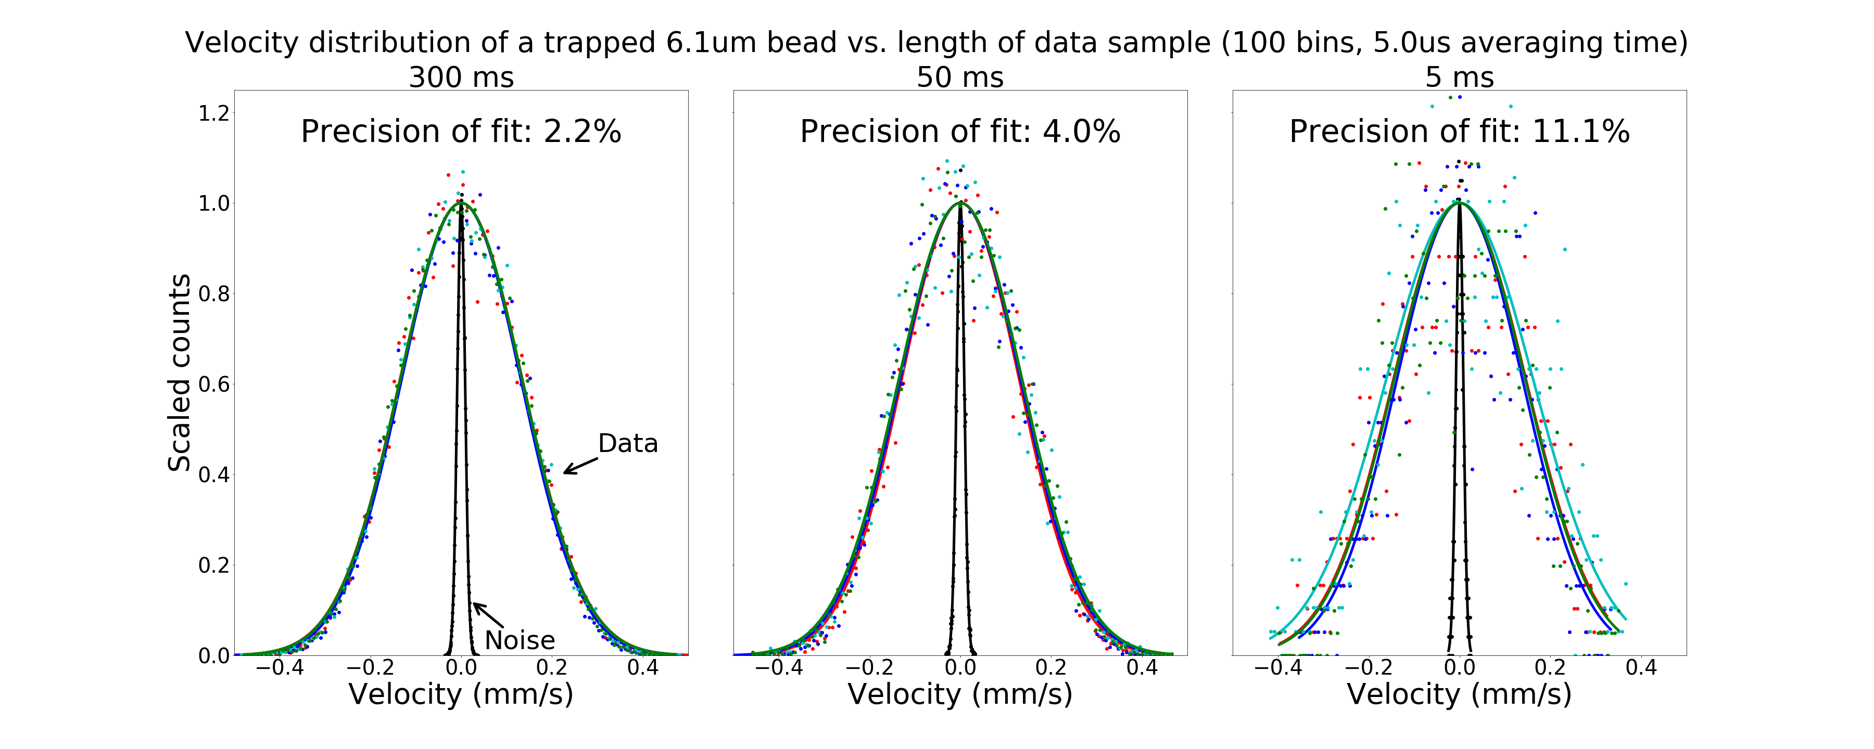
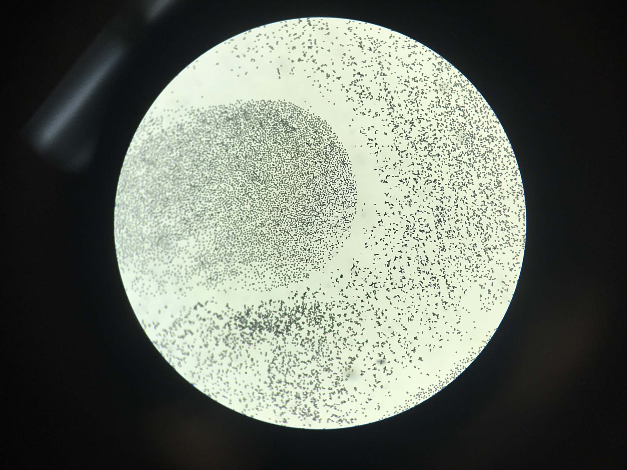

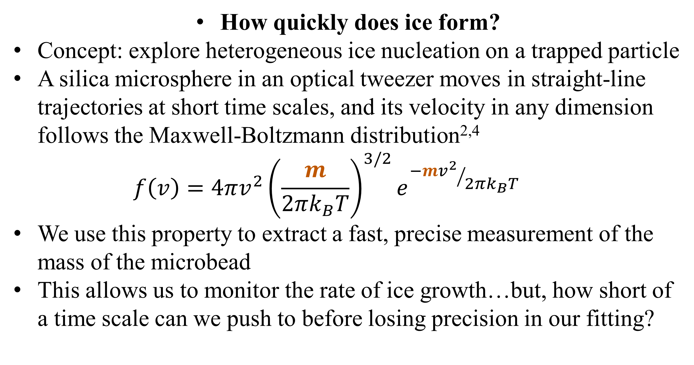
Using the instantaneous velocity of a Brownian particle in an optical tweezer to measure changes in mass
Gabriel H. Alvarez*, Julia E. Orenstein, Lichung Ha, Diney S. Ether Jr., Mark G. Raizen
University of Texas at Austin, Austin, TX (*Stanford University, Stanford, CA)
Motivation
Data and Results
Noise Canceling
How quickly does ice form?
Concept: explore heterogeneous ice nucleation on a trapped particle
A silica microsphere in an optical tweezer moves in straight-line trajectories at short time scales, and its velocity in any dimension follows the Maxwell-Boltzmann distribution^{2,4}
$$f\left(v\right)=4πv^{2}{\left(\frac{m}{2πk_{B}T}\right)}^{3/2}e^{{−mv^{2}}/{2πk_{B}T}}$$
We use this property to extract a fast, precise measurement of the mass of the microbead
This allows us to monitor the rate of ice growth…but, how short of a time scale can we push to before losing precision in our fitting?
After aligning the beams with a 5um pinhole, we are able to trap beads 3.17-6.10um in diameter
To increase our SNR, we average several positional values before obtaining instantaneous velocities and plotting their distribution against the model
We achieve 4.5Å resolution in 5us
Noise presents itself at specific frequencies which can be filtered from the Fourier transform
Finally, apply inverse Fourier transform after filtering out peaks (highlighted below in red)
Returns cleaner positional data
1cm
Experimental Setup
Counter-propagating dual-beam optical tweezer
Two orthogonally-polarized NIR (1064nm) beams used for trapping
Weak red (632nm) laser used for illumination
One trapping beam split by sharp mirror, used for detection
Balanced photodetector measures displacements of bead in 1D
CCD camera monitors light scattered by bead
Towards Observing Ice Nucleation
We can now take mass measurements in quick succession to observe a particle’s mass as it changes over time
The silica particle will act as a nucleation point, onto which we will blow cold humid air
Preliminary plans to supplement M-B fitting with measurement of Mie scattering from trapped sphere to estimate size of particle
New analytical tool that will finally enable the fundamental study of ice nucleation
Practical applications in cloud seeding, atmospheric science
Precision of Fit = $\frac{Standard deviation of mass measurements}{Mean mass}$
Silica microspheres (shown below) are applied to glass coverslip with Q-tip, launched from ultrasonic piezoelectric shaker
A
References
A
T. Li et al., Measurement of the instantaneous velocity of a Brownian particle. Science 328, 1673 (2010).
T. Li, Ph.D. thesis, University of Texas at Austin, 2011.
S. Kheifets et al., Observation of Brownian Motion in Liquids at Short Times: Instantaneous Velocity and Memory Loss. Science 343, 1493 (2014).
J. Mo et al., Testing the Maxwell-Boltzmann distribution using Brownian particles. Optics Express 23(2), 1888 (2015).
B
100um

